Slide 1
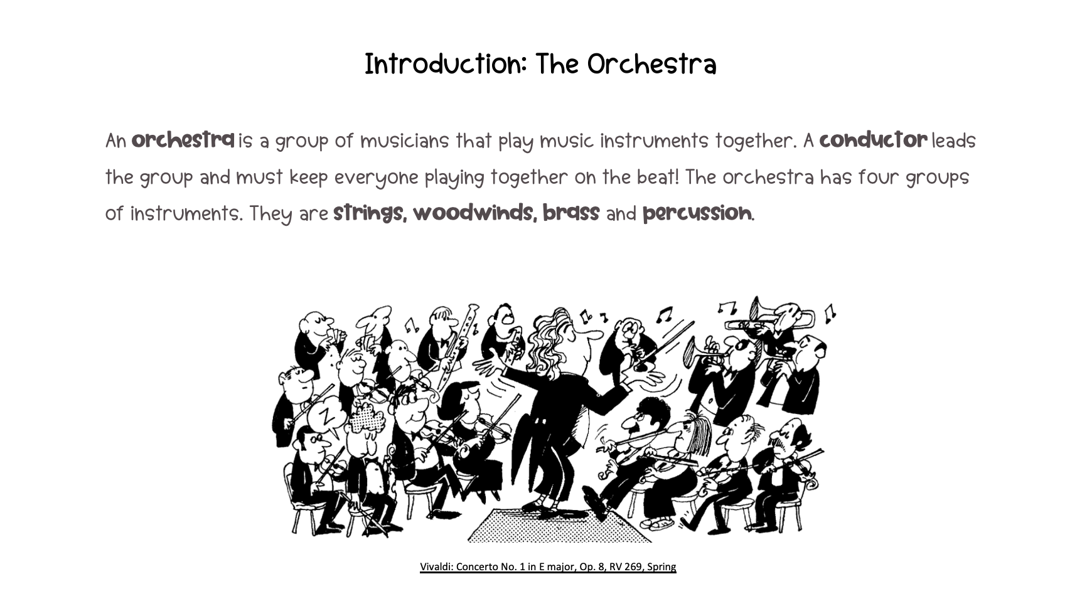



Slide 2
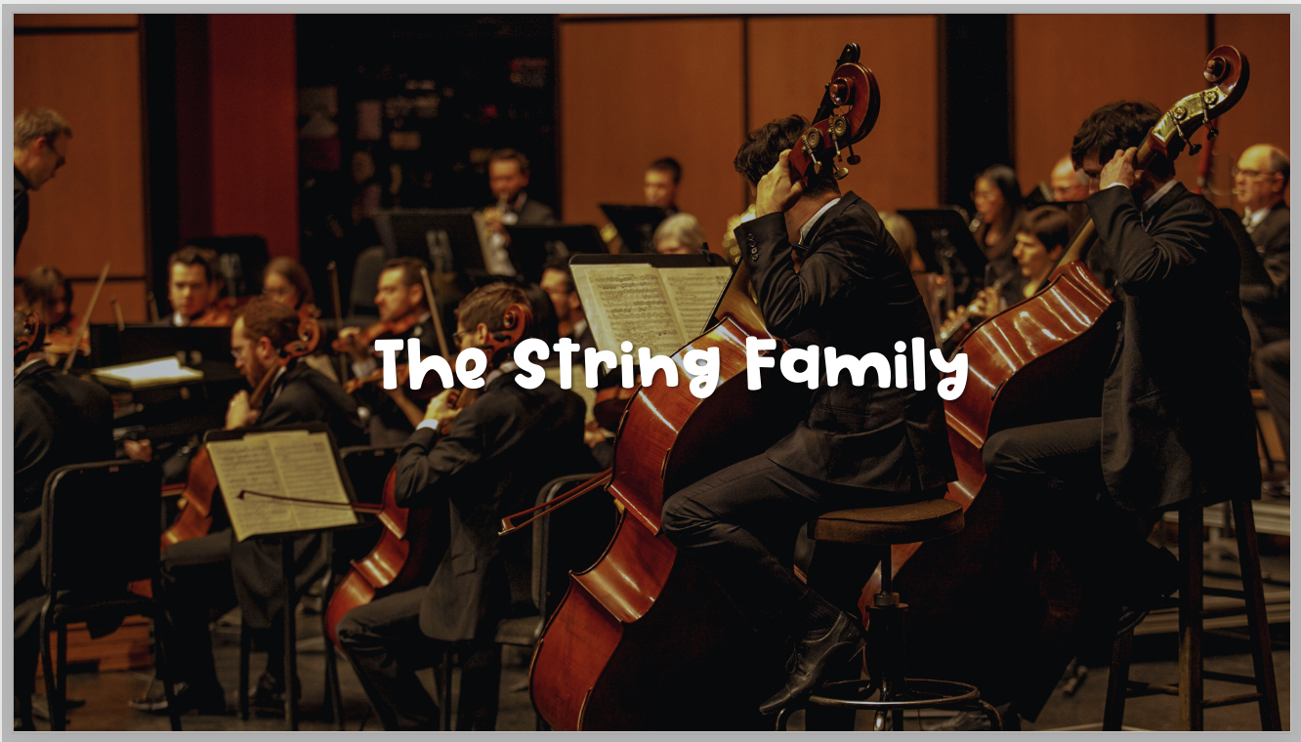

Slide 3

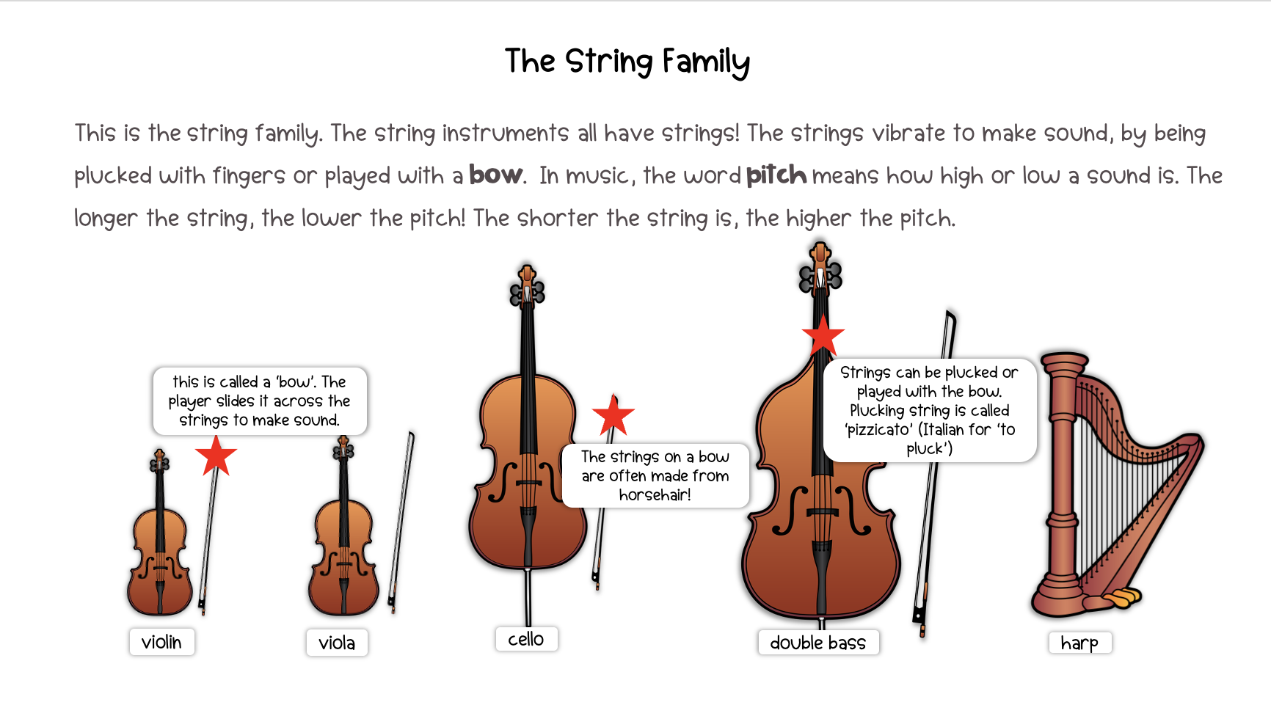

Slide 4
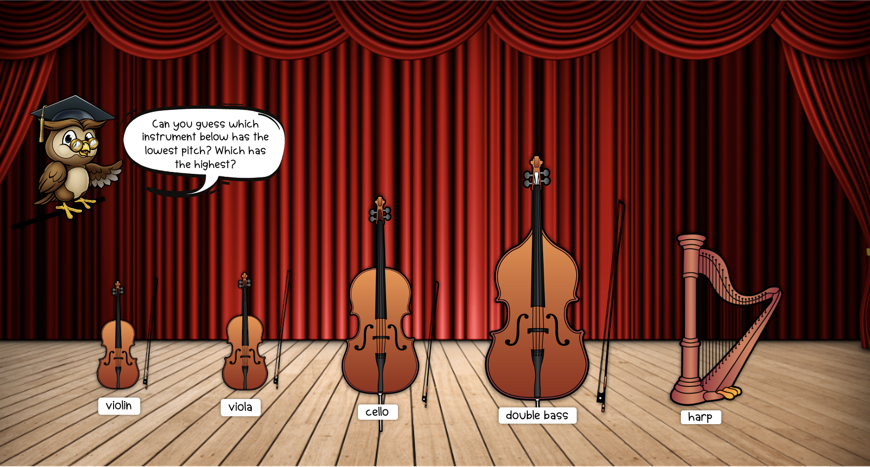

Slide 5
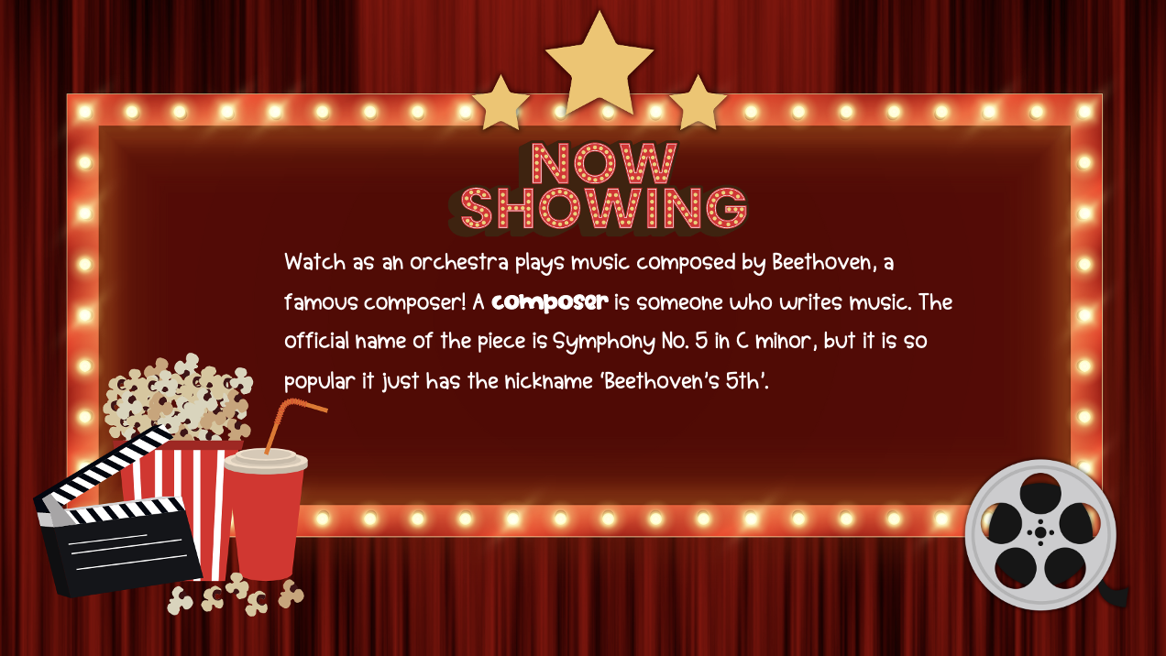
Watch as an orchestra plays music composed by Beethoven, a famous composer! A composer is someone who writes music. The official name of the piece is Symphony No. 5 in C minor, but it is so popular it just has the nickname ‘Beethoven’s 5th’.

Slide 6

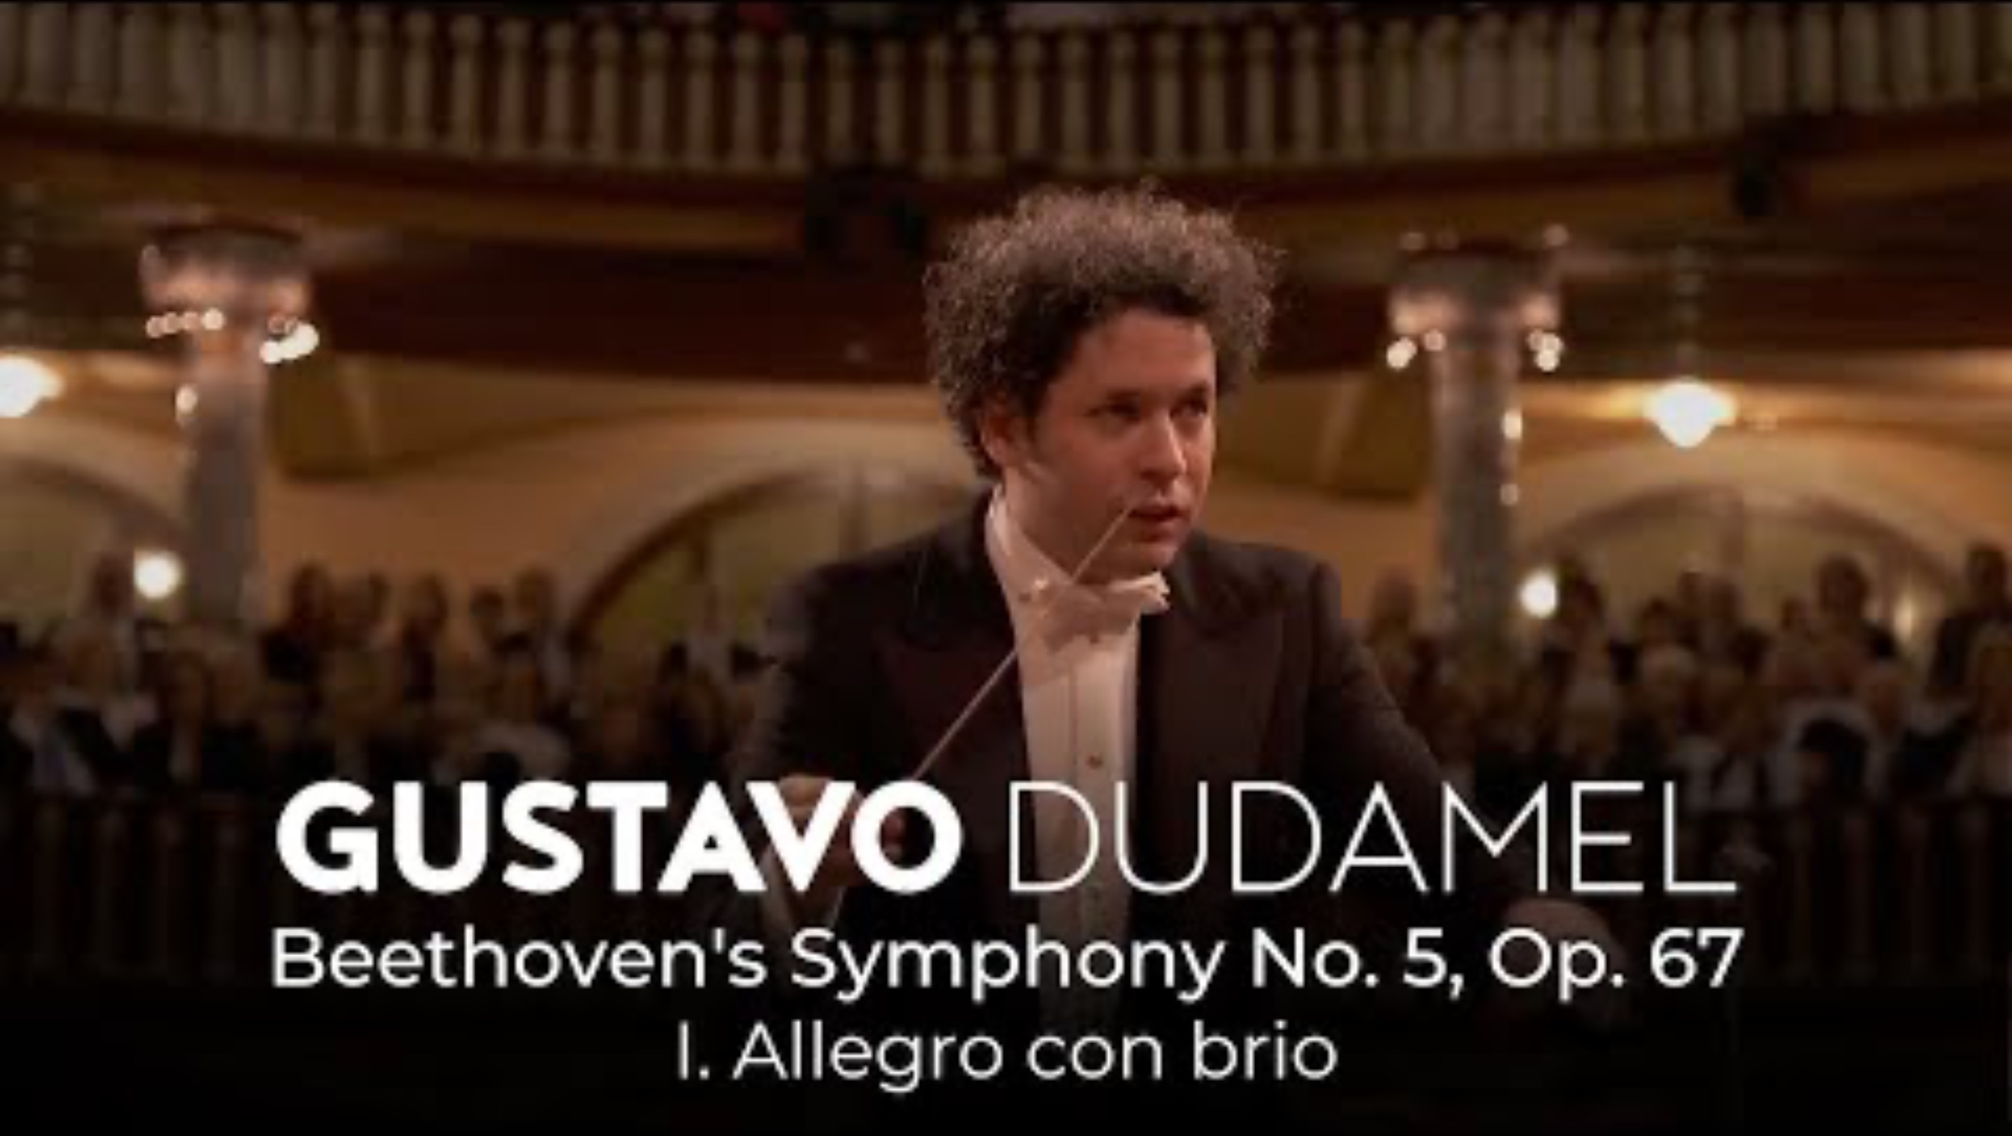
Video not playing? Click here to view on YouTube

Slide 7
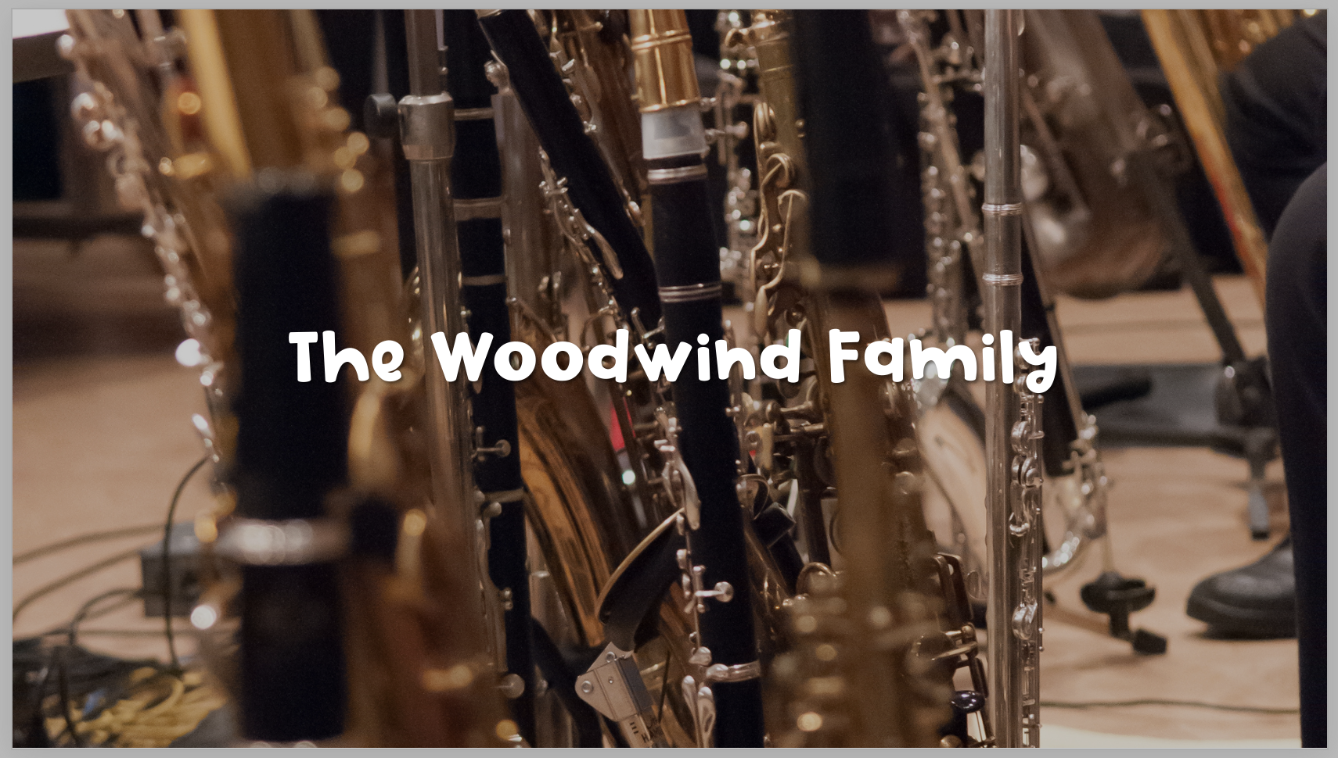

Slide 8
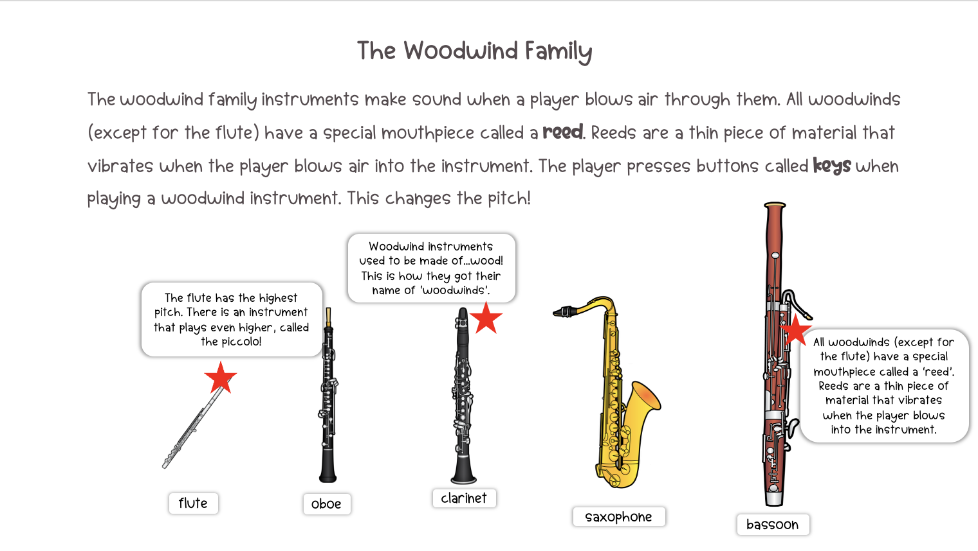

Slide 9
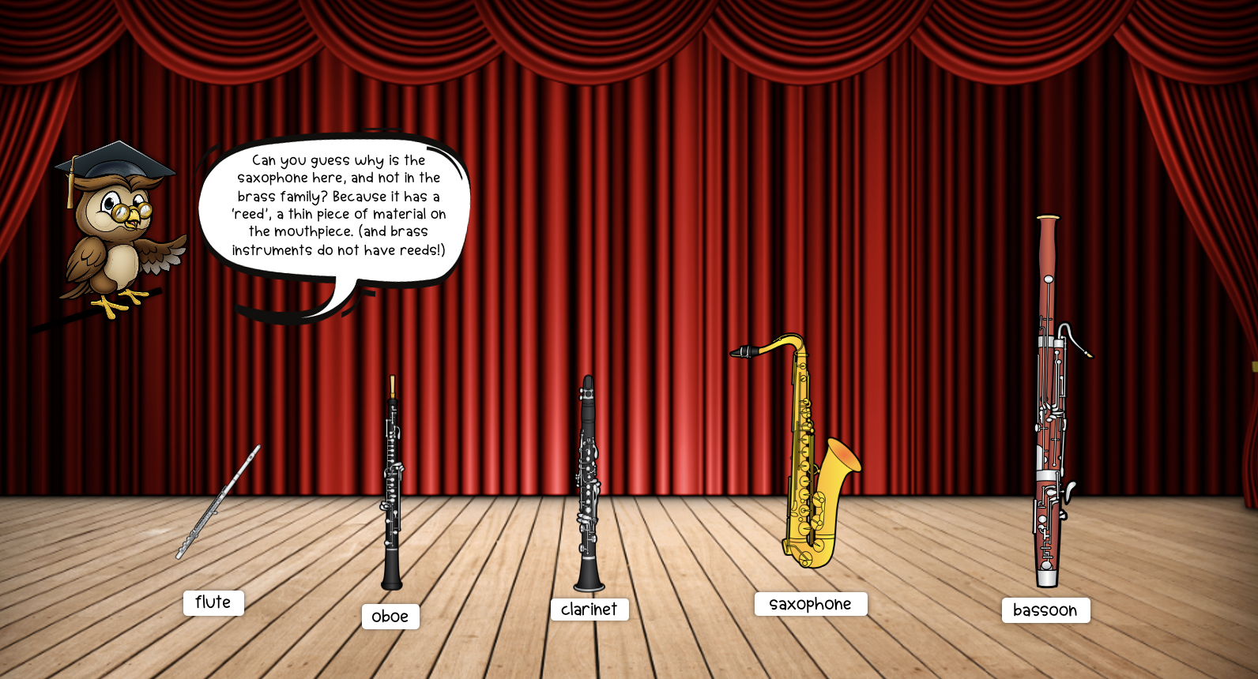

Slide 10


Slide 11
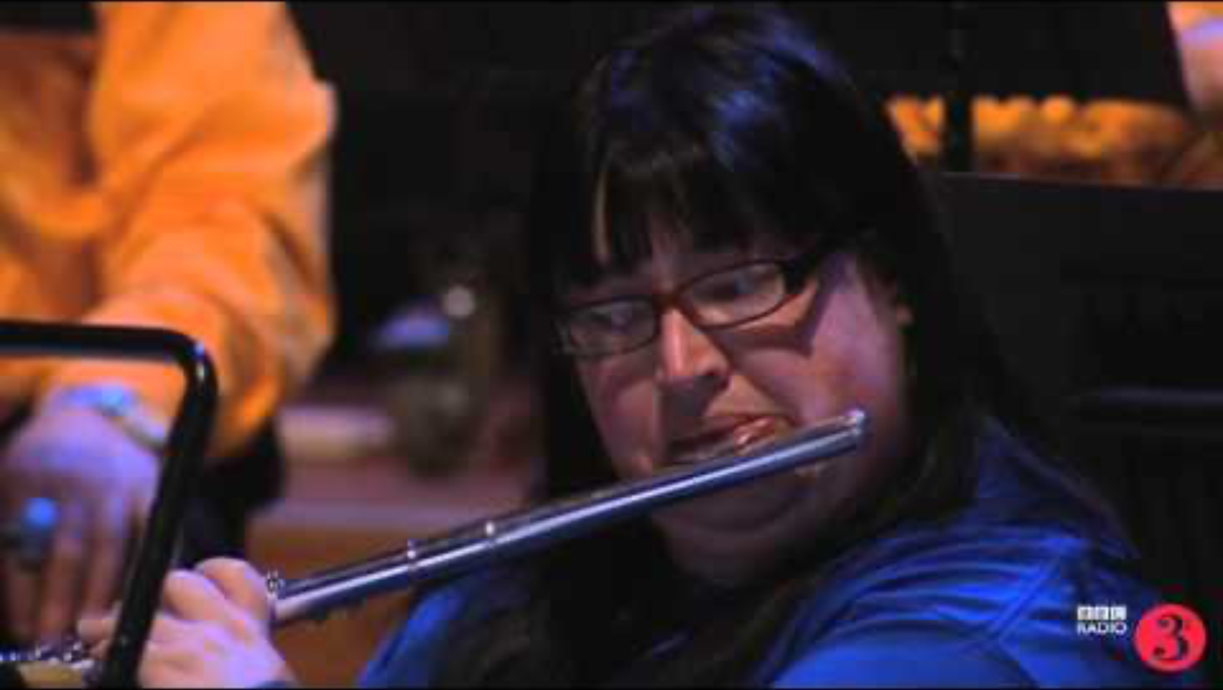
Video not playing? Click here to view on YouTube

Slide 12


Slide 13
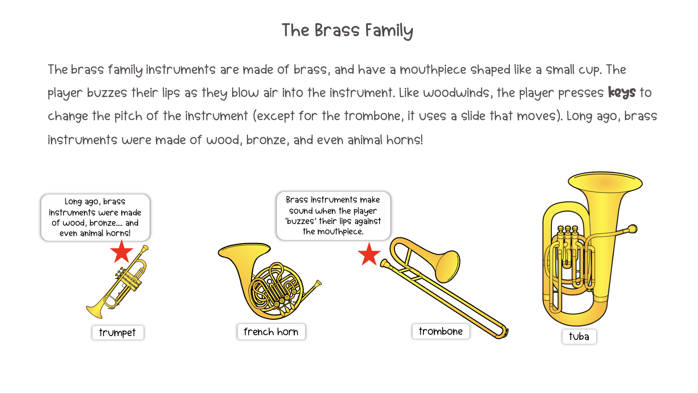

Slide 14
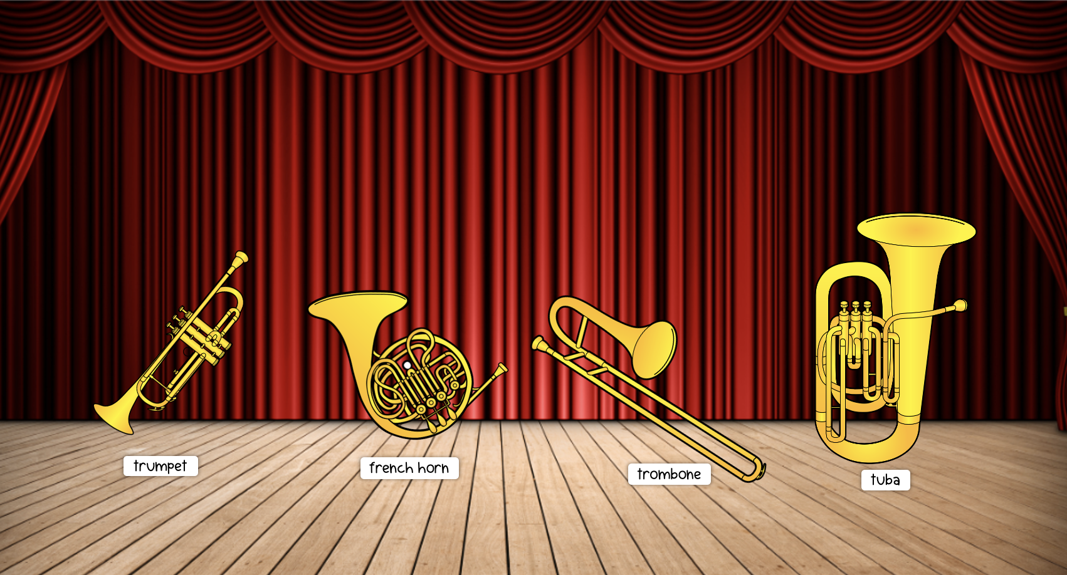

Slide 15


Slide 16
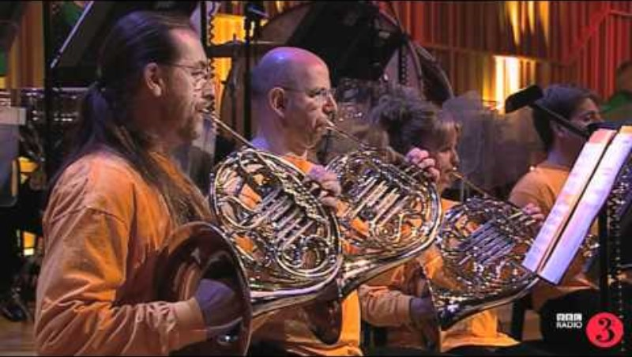
Video not playing? Click here to view on YouTube

Slide 17


Slide 18
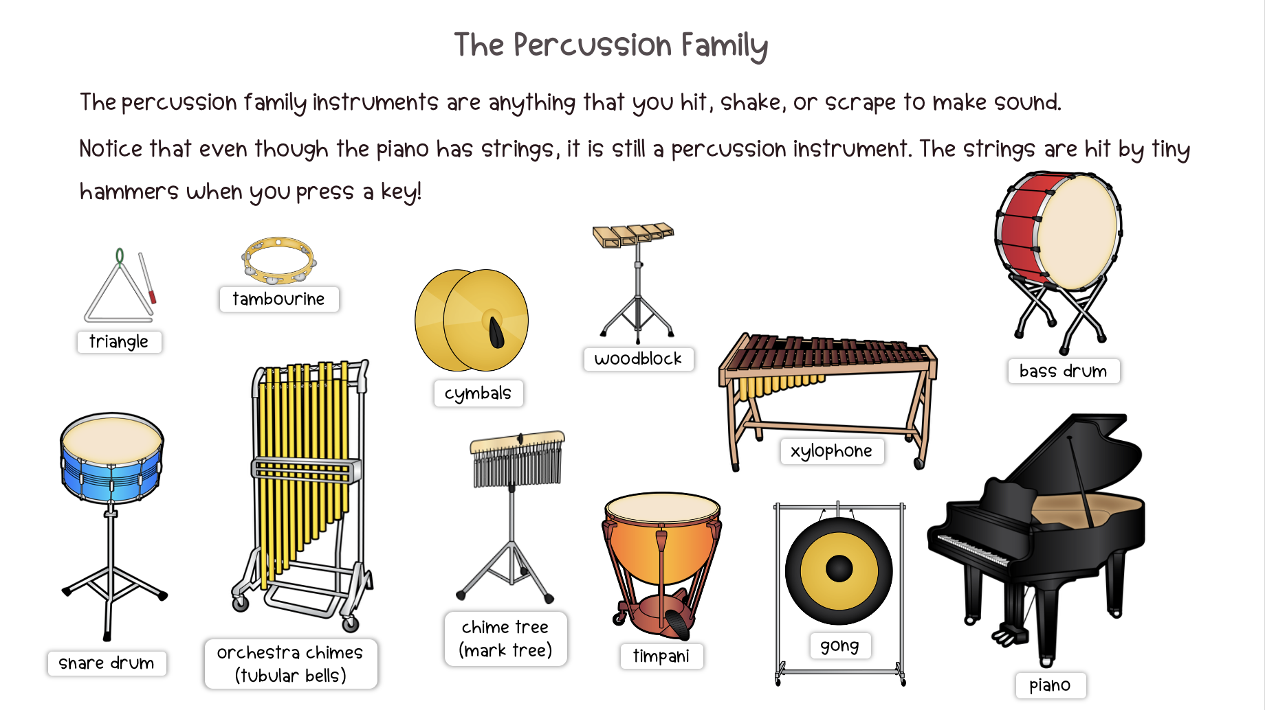

Slide 19
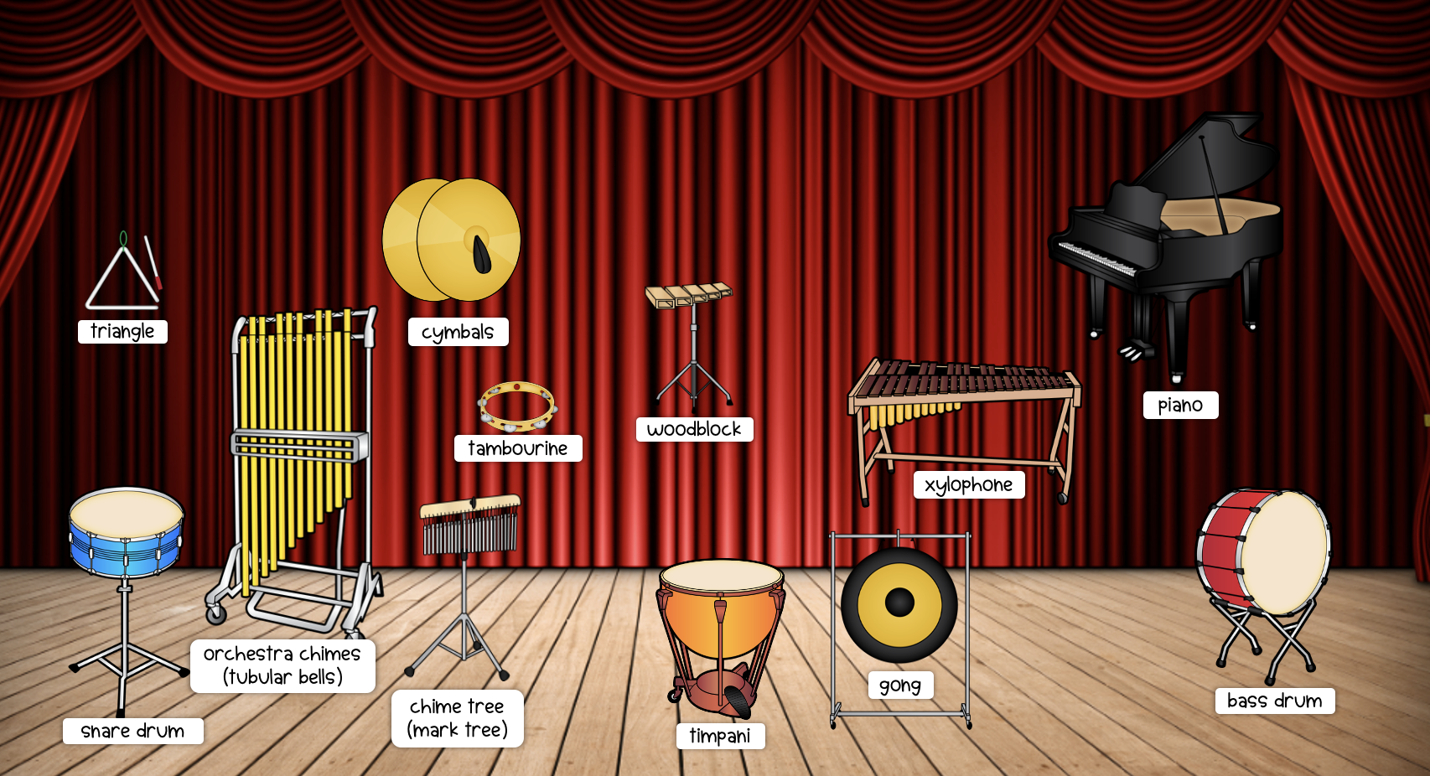

Slide 20

Watch as an orchestra plays instruments from the percussion family. There are many different instruments in the percussion family!

Slide 21
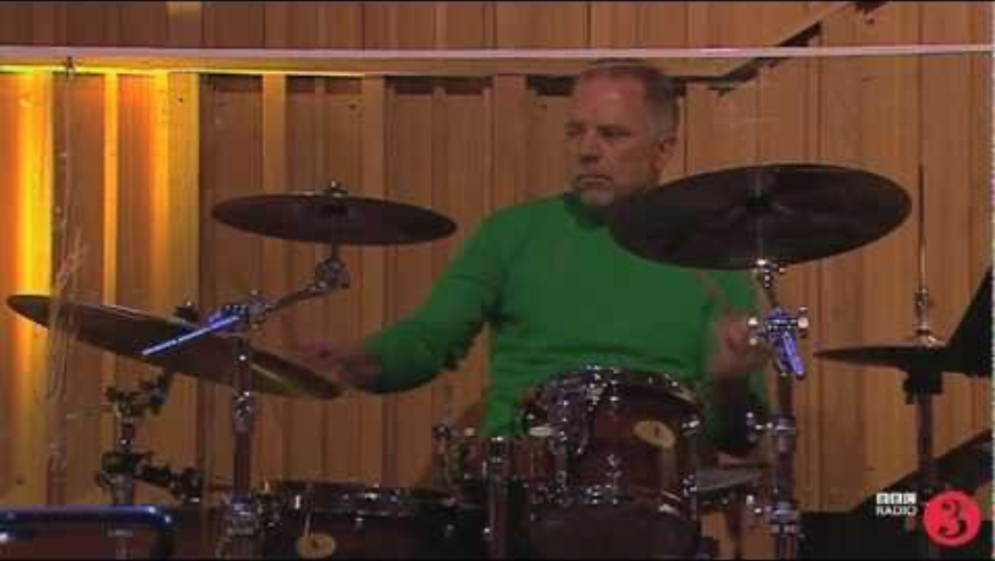
Video not playing? Click here to view on YouTube

Slide 22
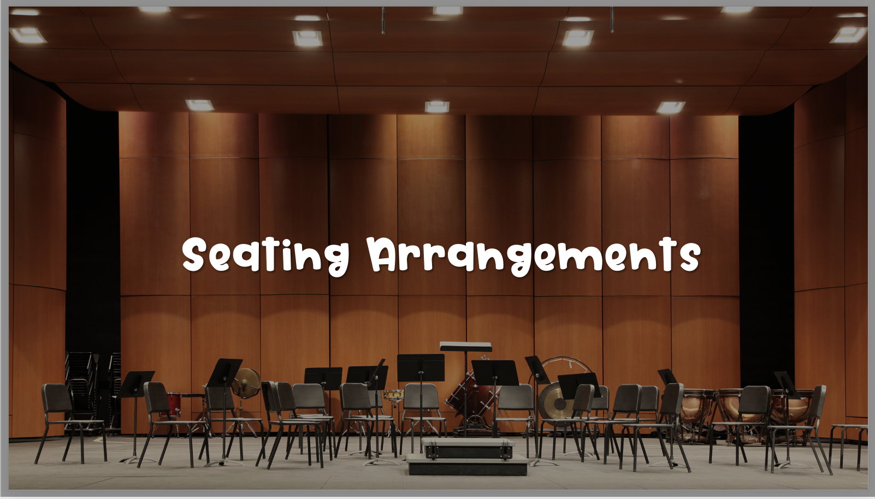

Slide 23


Slide 24
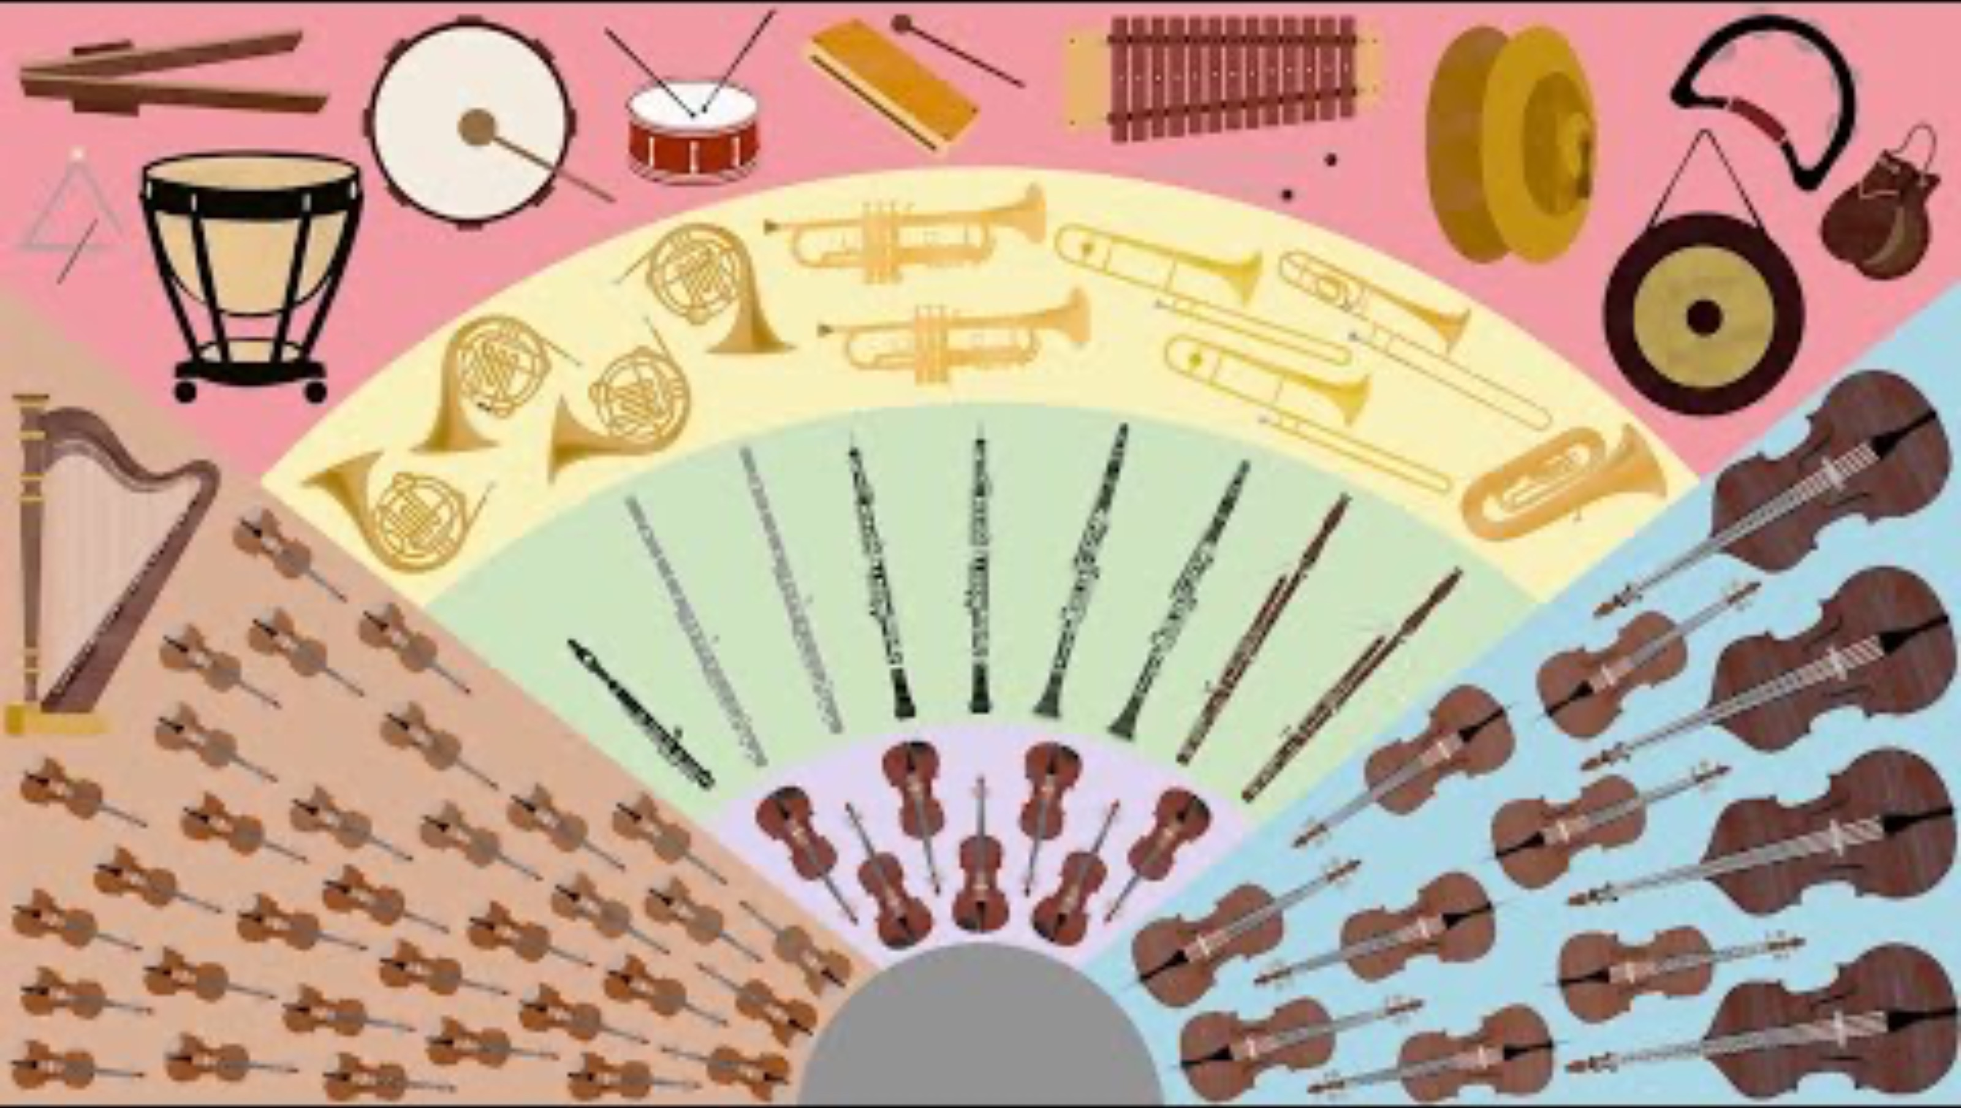
Video not playing? Click here to view on YouTube

